Slide 1
Multiple Regression

Slide 2
Introduction
Describe some of the differences between the multiple regression and bi-variate regression
Assess the importance of the R-squared statistic.
Examine the F-test and distribution
Show how we can use the F-test to determine joint significance.

Slide 3
Multiple Regression
In general the regression estimates are more reliable if:
i) n is large (large dataset)
ii) The sample variance of the explanatory variable is high.
iii) the variance of the error term is small
iv) The less closely related are the explanatory variables.

Slide 4
Multiple Regression
The constant and parameters are derived in the same way as with the bi-variate model. It involves minimising the sum of the error terms. The equation for the slope parameters (α) contains an expression for the covariance between the explanatory variables.
When a new variable is added it affects the coefficients of the existing variables

Slide 5
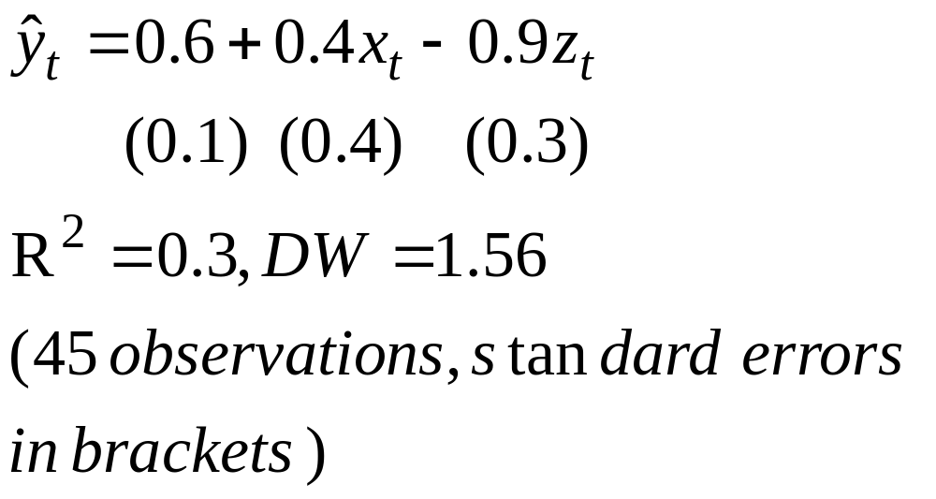
Regression

Slide 6
Regression
In the previous slide, a unit rise in x produces 0.4 of a unit rise in y, with z held constant.
Interpretation of the t-statistics remains the same, i.e. 0.4-0/0.4=1 (critical value is 2.02), so we fail to reject the null and x is not significant.
The R-squared statistic indicates 30% of the variance of y is explained
DW statistic indicates we are not sure if there is autocorrelation, as the DW statistic lies in the zone of indecision (Dl=1.43, Du=1.62)

Slide 7
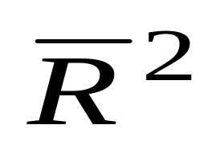
Adjusted R-squared Statistic
This statistic is used in a multiple regression analysis, because it does not automatically rise when an extra explanatory variable is added.
Its value depends on the number of explanatory variables
It is usually written as (R-bar squared):

Slide 8
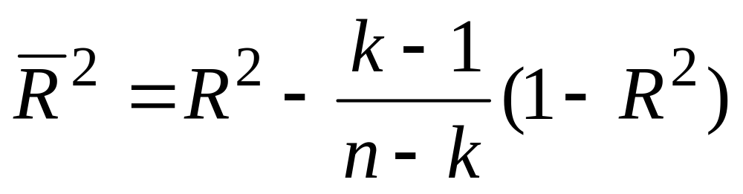
Adjusted R-squared
In generally rises when the t-statistic of an extra variable exceeds unity (1),so does not necessarily imply the extra variable is significant.
It has the following formula (n-number of observations, k-number of parameters):

Slide 9
The F-test
The F-test is an analysis of the variance of a regression
It can be used to test for the significance of a group of variables or for a restriction
It has a different distribution to the t-test, but can be used to test at different levels of significance
When determining the F-statistic we need to collect either the residual sum of squares (RSS) or the R-squared statistic
The formula for the F-test of a group of variables can be expressed in terms of either the residual sum of squares (RSS) or explained sum of squares (ESS)

Slide 10
F-test of explanatory power
This is the F-test for the goodness of fit of a regression and in effect tests for the joint significance of the explanatory variables.
It is based on the R-squared statistic
It is routinely produced by most computer software packages
It follows the F-distribution, which is quite different to the t-test

Slide 11
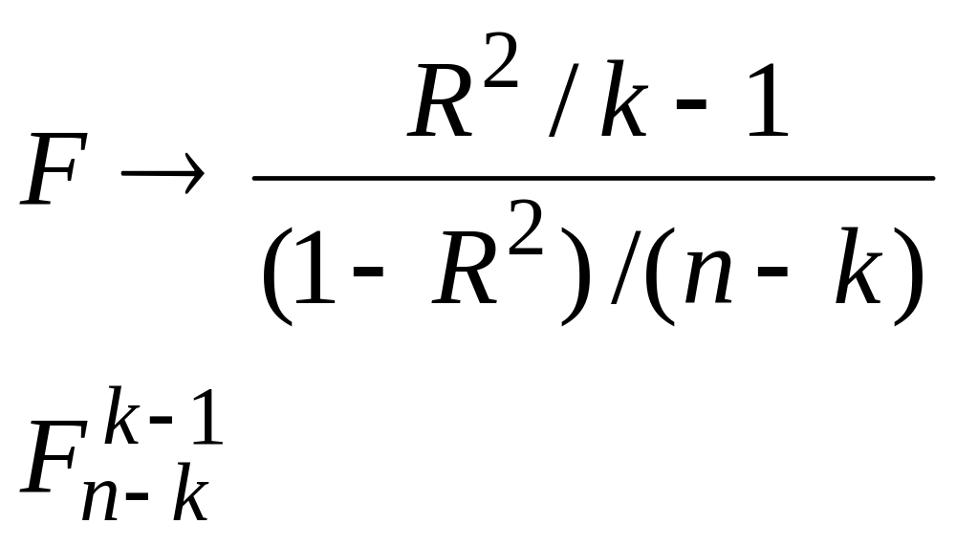
F-test formula
The formula for the F-test of the goodness of fit is:

Slide 12
F-distribution
To find the critical value of the F-distribution, in general you need to know the number of parameters and the degrees of freedom
The number of parameters is then read across the top of the table, the d of f. from the side. Where these two values intersect, we find the critical value.

Slide 13
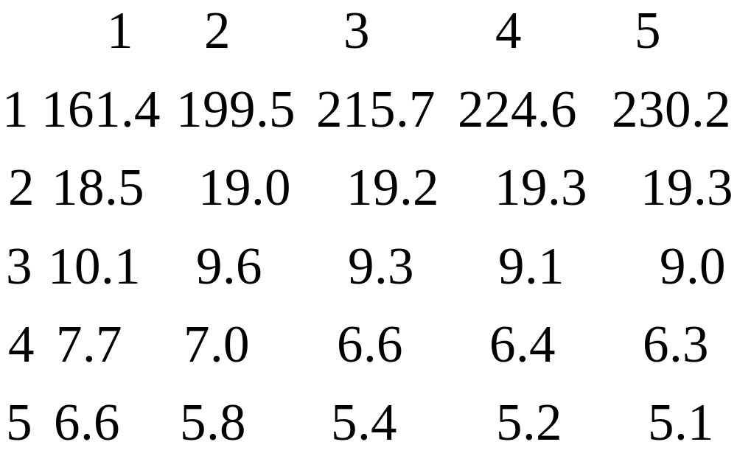
F-test critical value

Slide 14
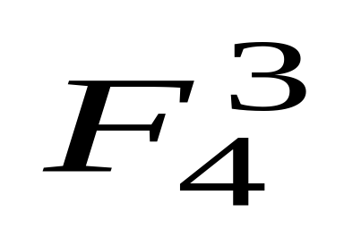
F-distribution
Both go up to infinity
If we wanted to find the critical value for F(3,4), it would be 6.6
The first value (3) is often termed the numerator, whilst the second (4) the denominator.
It is often written as:

Slide 15
F-statistic
When testing for the significance of the goodness of fit, our null hypothesis is that the explanatory variables jointly equal 0.
If our F-statistic is below the critical value we fail to reject the null and therefore we say the goodness of fit is not significant.

Slide 16
Joint Significance
The F-test is useful for testing a number of hypotheses and is often used to test for the joint significance of a group of variables
In this type of test, we often refer to ‘testing a restriction’
This restriction is that a group of explanatory variables are jointly equal to 0

Slide 17
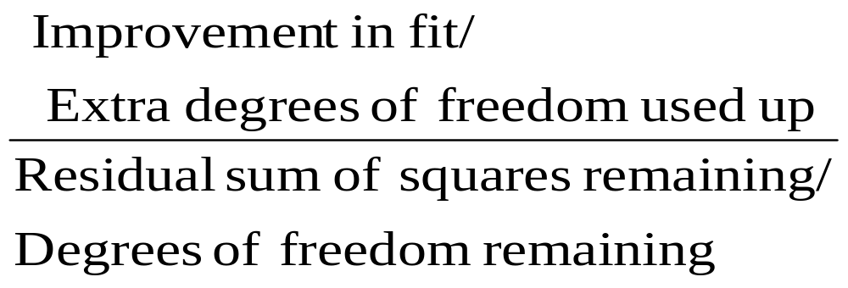
F-test for joint significance
The formula for this test can be viewed as:

Slide 18
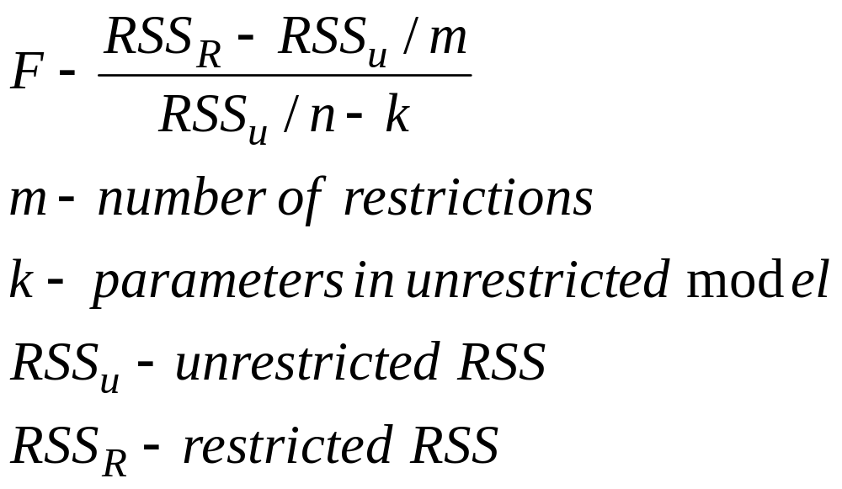
F-tests
The test for joint significance has its own formula, which takes the following form:

Slide 19
Joint Significance of a group of variables
To carry out this test you need to conduct two separate OLS regression, one with all the explanatory variables in (unrestricted equation), the other with the variables whose joint significance is being tested, removed.
Then collect the RSS from both equations.
Put the values in the formula
Find the critical value and compare with the test statistic. The null hypothesis is that the variables jointly equal 0.

Slide 20
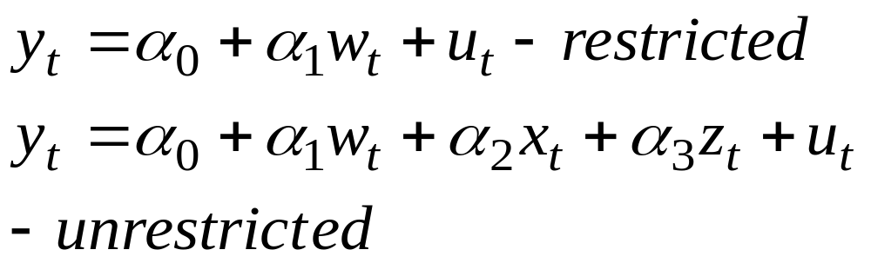
Joint Significance
If we have a 3 explanatory variable model and wish to test for the joint significance of 2 of the variables (x and z), we need to run the following restricted and unrestricted models:

Slide 21
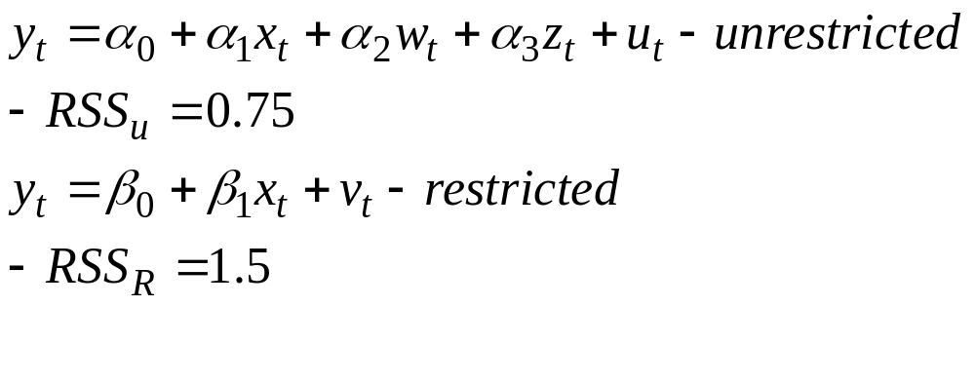
Example of the F-test for joint significance
Given the following model, we wish to test the joint significance of w and z. Having estimated them, we collect their respective RSSs (n=60).

Slide 22
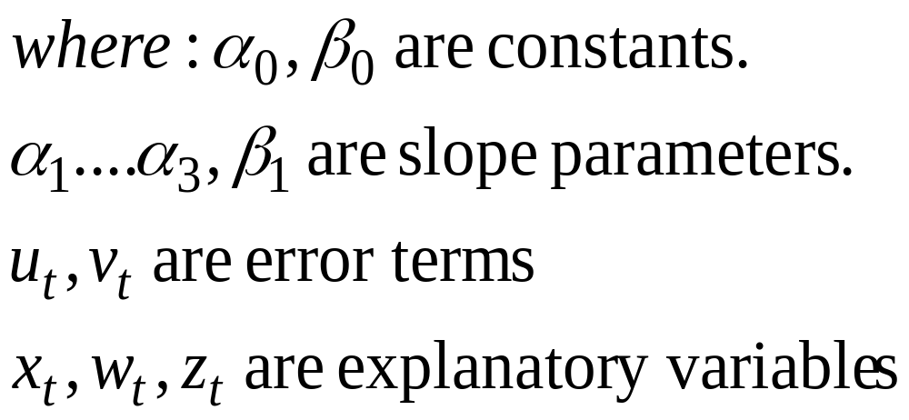
Joint significance

Slide 23
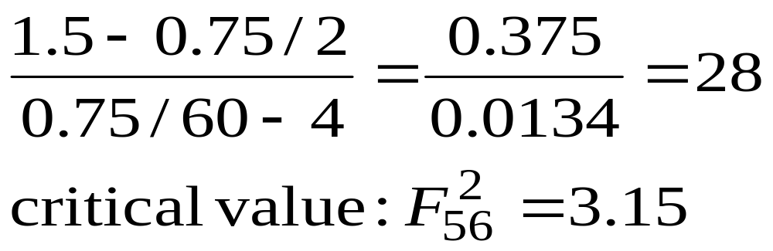
Joint significance
Having obtained the RSSs, we need to input the values into the earlier formula (slide 18):

Slide 24
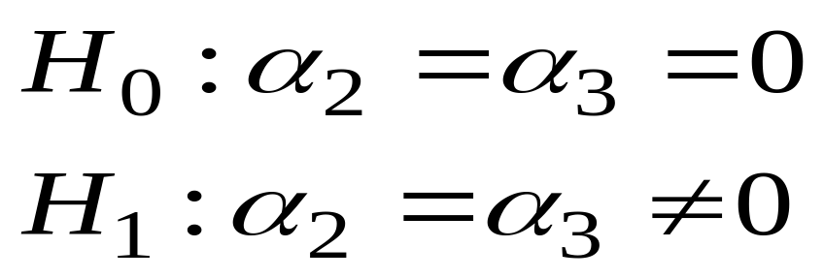
Joint significance
As the F statistic is greater than the critical value (28>3.15), we reject the null hypothesis and conclude that the variables w and z are jointly significant and should remain in the model.

Slide 25
Conclusion
Multiple regression analysis is similar to bi-variate analysis, however correlation between the x variables needs to be taken into account
The adjusted R-squared statistic tends to be used in this case
The F-test is used to test for joint explanatory power of the whole regression or a sub-set of the variables
We often use the F-test when testing for things like seasonal effects in the data.

